Slide 1
AI-Powered Customer Churn & RFM Segmentation Transforming Customer Data into Actionable Business Insights
Created by: Moin Farooqui

Slide 2
What problem are we solving?
Businesses often struggle to identify customers who may stop purchasing.
Traditional analysis identifies churn only after it happens.
This project uses Machine Learning and AI to identify at-risk customers and recommend proactive retention strategies.

Slide 3

Project Workflow
Customer Data
↓
Data Cleaning
↓
RFM Analysis
↓
Customer Segmentation
↓
Churn Prediction
↓
GenAI Recommendations
↓
Power BI Dashboard

Slide 4

Dataset Overview
49,673 Customers
Customer transactions
Product categories
Purchase history
Returns
Churn information

Slide 5
RFM Analysis & Segmentation
RFM Analysis was used to evaluate customer purchasing behavior based on three key metrics.
RECENCY How recently a customer made a purchase.
FREQUENCY How often a customer makes purchases.
MONETARY VALUE How much money a customer spends.
These metrics provide a structured approach to identifying high-value and low-engagement customers.

Slide 6
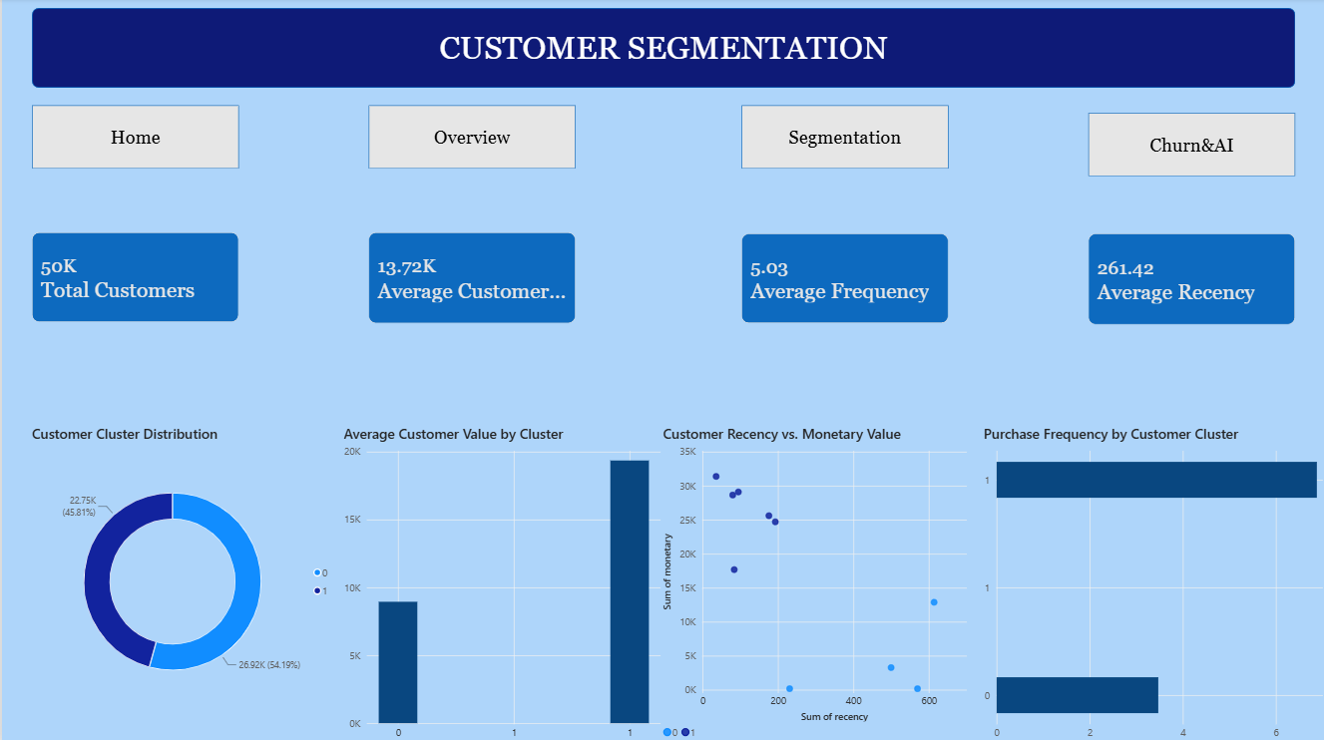
Customer Segmentation

Slide 7

CUSTOMER CHURN PREDICTION
A Random Forest Machine Learning model was used to predict the probability of customer churn.
The model analyzes customer behavior and generates a churn probability score for each customer.
Customers were categorized into risk levels:
• Low Risk
• Medium Risk
• High Risk

Slide 8
AI-POWERED RETENTION ENGINE
High-risk customer profiles were analyzed using Google Gemini AI.
The AI retention engine considers:
• Customer Purchase Behavior
• Recency of Activity
• Purchase Frequency
• Customer Spending
• Churn Probability
• Customer Segment

Slide 9
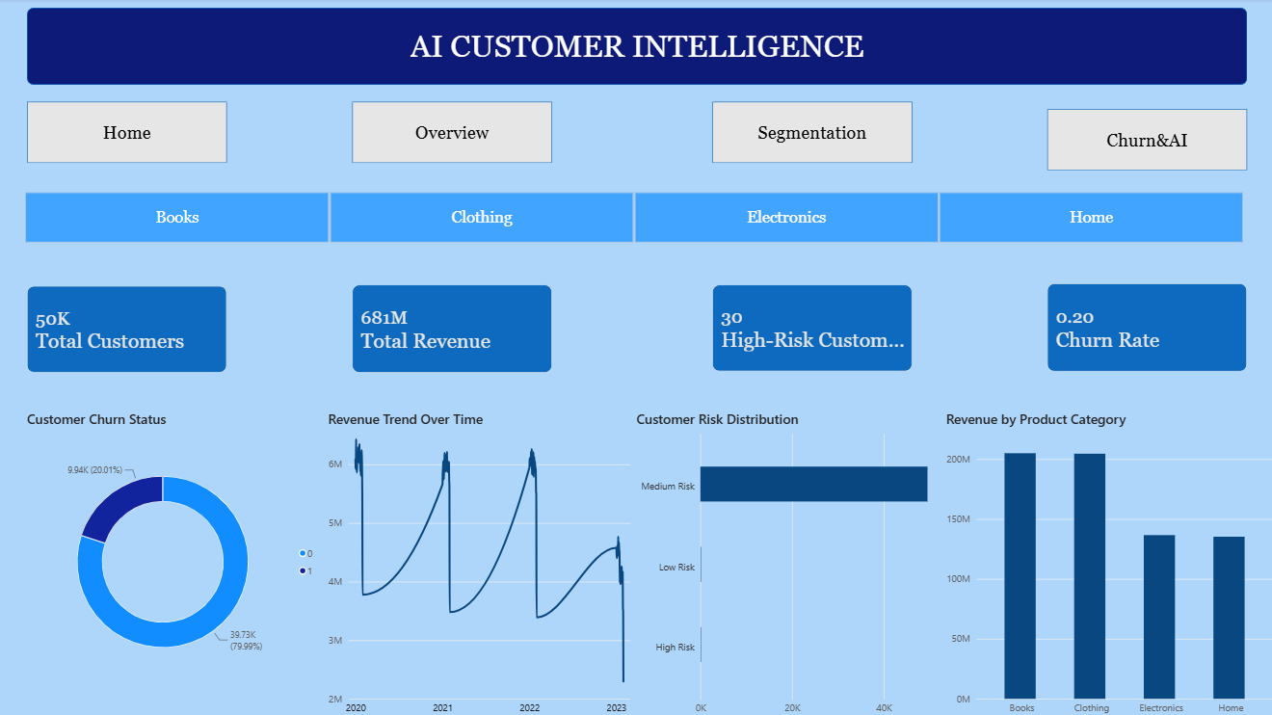
INTERACTIVE POWER BI DASHBOARD
A multi-page Power BI dashboard was developed to transform the analytical results into interactive business intelligence.
The dashboard provides:
• Executive Customer Overview
• Revenue and Churn Analysis
• Customer Segmentation Insights
• High-Risk Customer Identification
• AI-Powered Retention Recommendations
The interactive dashboard helps transform complex analytical results into actionable business insights.

Slide 10
BUSINESS RECOMMENDATIONS
• Prioritize high-risk customers for retention campaigns.
• Protect high-value customers through loyalty programs and exclusive benefits.
• Re-engage inactive customers using personalized offers.
• Use customer segments to design targeted marketing strategies.
• Combine Machine Learning predictions with Generative AI recommendations to support proactive business decisions.

Slide 11
CONCLUSION
This project demonstrates how Data Analytics, Machine Learning, Business Intelligence, and Generative AI can work together to transform customer data into actionable insights.
By combining RFM Analysis, K-Means Clustering, Random Forest Churn Prediction, Gemini AI, and Power BI, the project provides a complete framework for understanding customer behavior and supporting proactive retention strategies.
THANK YOU

